Slide 1

MICROSOFT MOVIE STUDIO ANALYSIS
Sabina Bains
October 2021

Slide 2
OBJECTIVE AND METHODOLOGY
Explore historical movie data to determine types of movies that are most successful at the box office for Microsoft’s studio to utilize. This exploratory analysis dives into the following topics:
Genre Analysis
Crew Analysis
Monthly Trends
Data is sourced from The Numbers (https://www.the-numbers.com/) and IMDB (https://www.imdb.com)

Slide 3

OVERALL FINDINGS

Slide 4
Key findings
Animation, Adventure, and Sci-Fi genres generate the highest profits while maintaining low relative costs on average.
Experienced crew members in the Animation genre such as Pierre Coffin as Director, Janet Healy as producer, and Michael Giacchino as composer are responsible for multiple of the most successful films.
Film releases in May generate the largest worldwide gross on average.

Slide 5
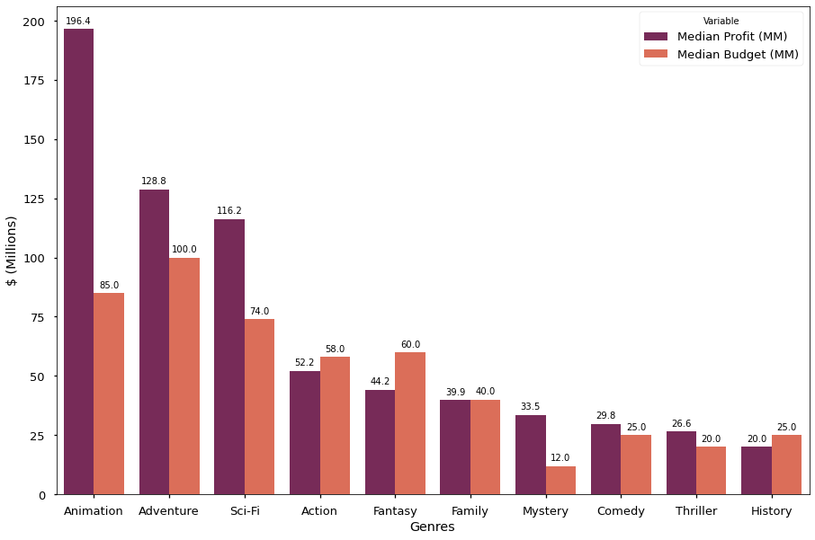
Films in the Animation genre are most profitable on average, while costing less than half their NET earnings
Median Profit and Budget (MM) by Genre
Animation films outperformed all other genres with a median profit of 196.4MM. Median budget for this genre was 85MM.
Adventure and Sci-Fi genres have high average profits as well while keeping low relative costs
Action and Fantasy genres have higher budgets than profit on average
Using the median excludes potential outliers in films, demonstrating Animation films as a clear winner
Data sourced from The Numbers (https://www.the-numbers.com/) and IMDB (https://www.imdb.com)

Slide 6
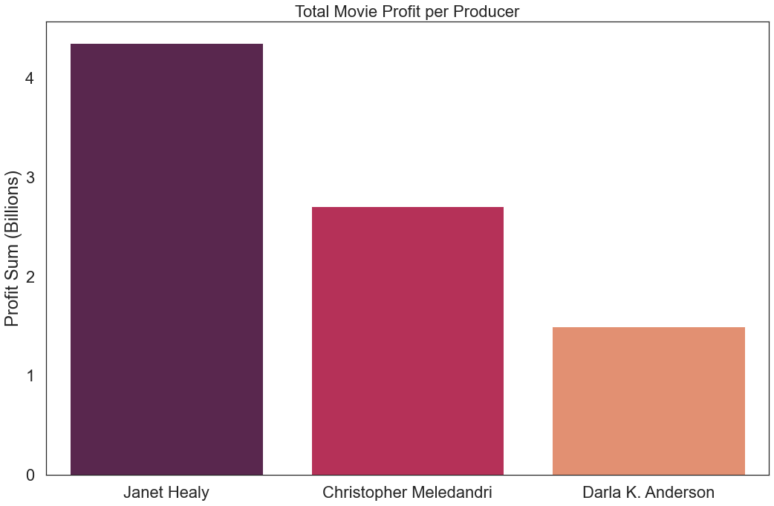
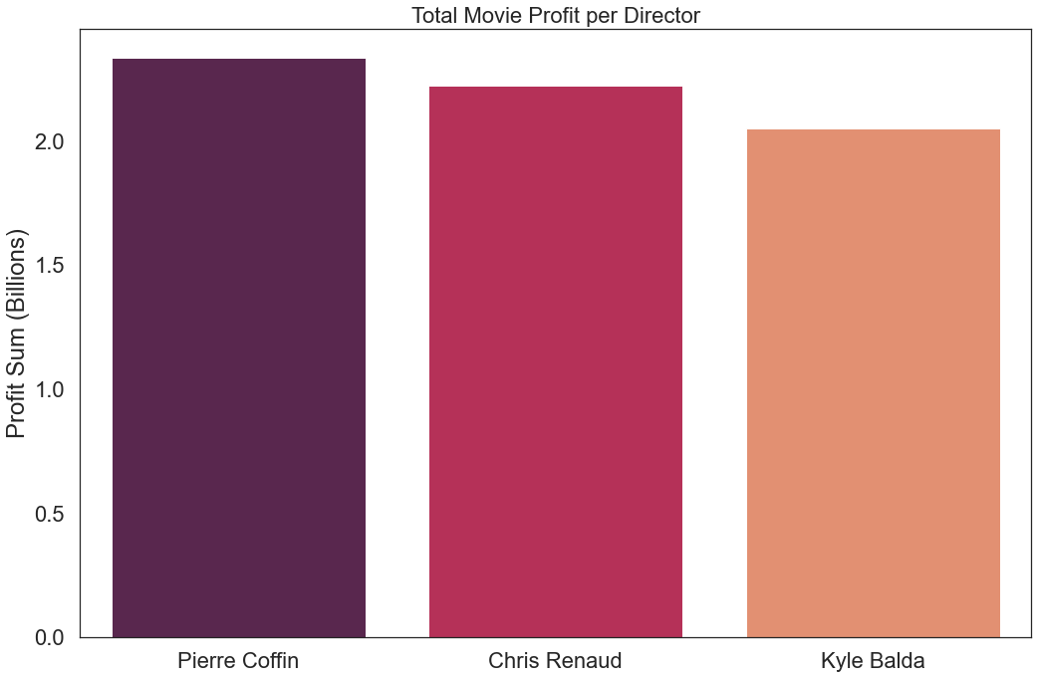
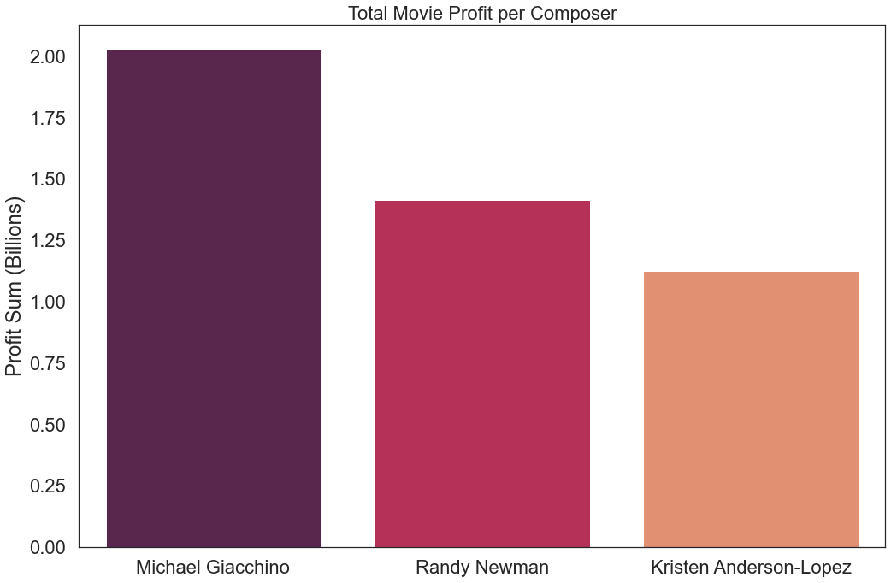
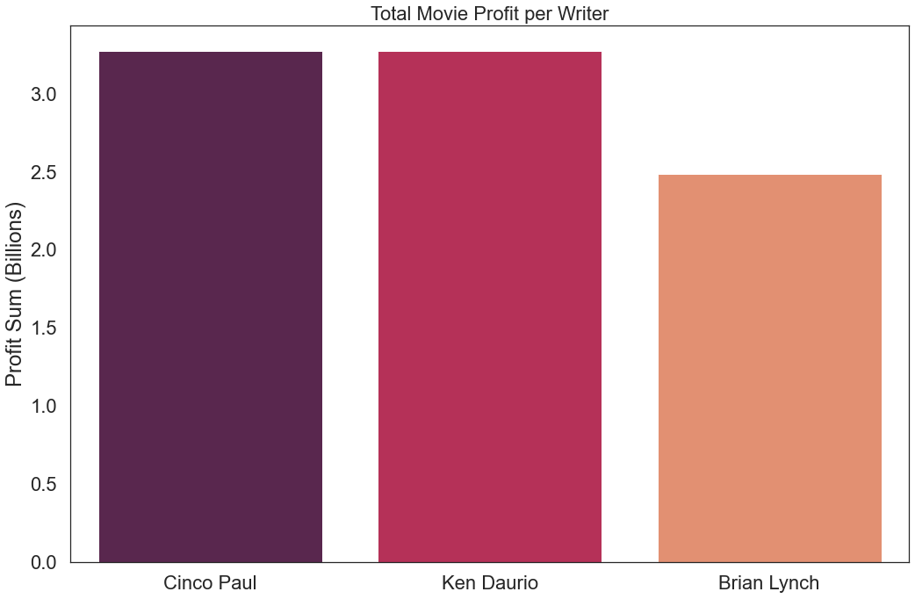
Hiring experienced crew members contribute to Successful FILMS
Janet Healy is the most profitable producer in the Animation Genre with 7 works.
Pierre Coffin is the most successful director in Animation, most notable for the Despicable Me franchise
Michael Giacchino tops the list of most successful Animation composers. His experience varies across genres, exuding versatility
Cinco Paul and Ken Daurio write the most successful animation films
Data sourced from The Numbers (https://www.the-numbers.com/) and IMDB (https://www.imdb.com)

Slide 7
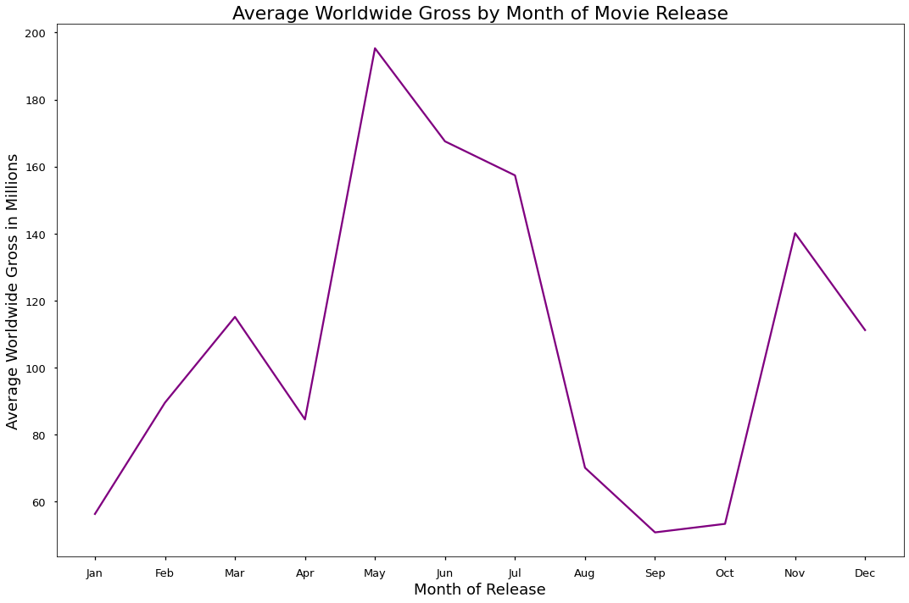
MAY FILM RELEASES GENERATE THE HIGHEST WORLDWIDE GROSS ON AVERAGE
Release Month | Gross (MM)
Jan | 81.0
Feb | 140.0
Mar | 172.9
Apr | 152.1
May | 240.0
Jun | 227.1
Jul | 189.3
Aug | 91.0
Sep | 66.3
Oct | 72.9
Nov | 179.4
Dec | 117.0
Movies released in late spring to early summer generate substantial worldwide gross earnings, with May generating 240MM on average.
Late summer and early fall movie releases yield the lowest worldwide gross on average
Data sourced from The Numbers (https://www.the-numbers.com/) and IMDB (https://www.imdb.com)

Slide 8


CONCLUSIONS and next steps:
Kick off Microsoft’s movie studio by creating an animation film, as this genre generates the highest profits with minimal risk of costing more than its gross earnings. Adventure and Sci-Fi films also generate high profits with relatively low budgets.
Utilizing experienced crew members in the Animation genre such as Pierre Coffin as Director, Janet Healy as Producer, and Michael Giacchino as composer will yield successful films.
Microsoft should prioritize releasing films in May, June, or July, as viewers are more likely to hit the movie theatre in these months. Avoid delaying movie releases, as late summer and early fall generate the lowest gross among films.

